Slide 1
HOTEL RATING CLASSIFICATION

Slide 2

Presented by:
Rupal Meshram GUIDED BY :-
Shubham Shelke Adhavaith SIR
Harshavardhan malgi
Pooja Phadake
Prajakta Sapkal
Manasi Bhabad
Dhanashri Bhabad

Slide 3
INTRODUCTION:-
The aim of this project is to develop a system that can accurately classify the rating of hotels based on customer reviews and other relevant information. This can help hotel owners understand the strengths and weaknesses of their establishments and improve customer satisfaction.
We will be discussing the methodology used, the data sources and pre-processing steps, the various models we tried and the results we obtained.

Slide 4
Objective:-
T and major objective is what are the attributes that travelers are considering while selecting a hotel. With this management can understand which elements of their hotel influence more in forming a positive review or improves hotel brand image.

Slide 5
Libraries :-
import numpy as np
import pandas as pd
import string
import spacy
import seaborn as sns
from matplotlib.pyplot import imread
from matplotlib import pyplot as plt
from wordcloud import WordCloud
%matplotlib inline

Slide 6
Understanding the Data:-
The dataset includes information about:
The data file Hotel rating classification
contains 20491 rows and 2 columns.
The data of 20491 rows and explain the
reviews given by the customers and the
ratings given by them.

Slide 7
Exploratory data analysis (EDA)
Exploratory Data Analysis (EDA) is an approach
to analyse the data using visual techniques.
The data types is in form of float and
objective.
The dataset has no missing values or duplicate
values.

Slide 8
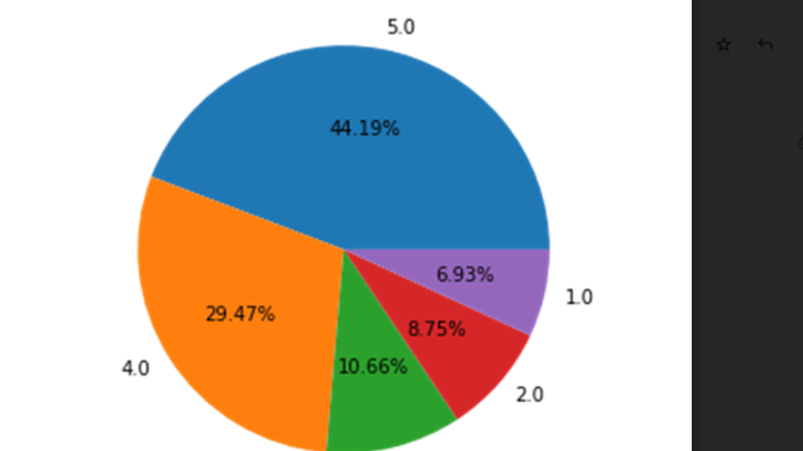
Data Visualization:-
Pie chart shows that
distribution of data in
percentage wise of rating.
Large amount of data
distributed in4 and 5 rating
i.e. 29.47% and 44.19%
respectively.

Slide 9
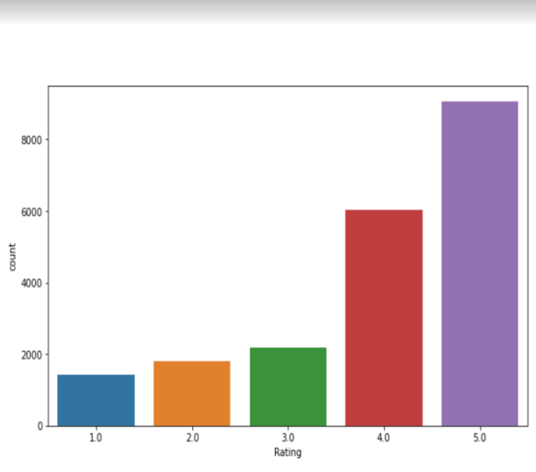
Count plot
The count plot shows that rating of the customer.
This is Highest rating is the 5 and 4.

Slide 10
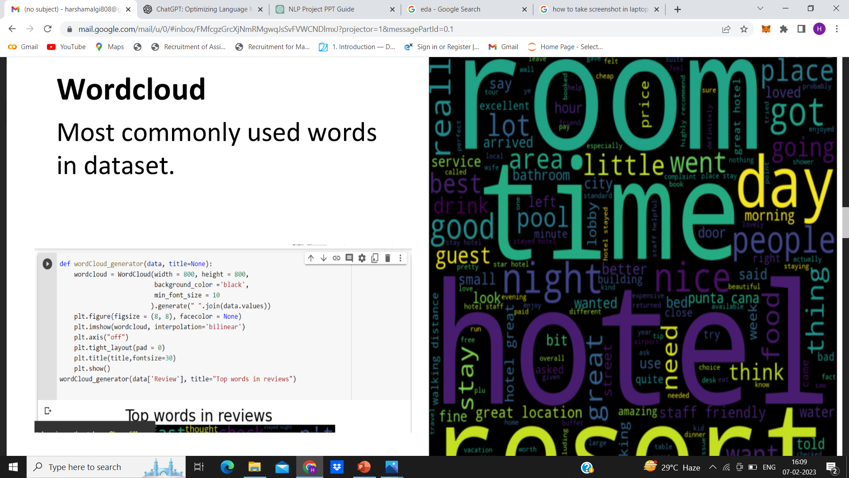

Slide 11
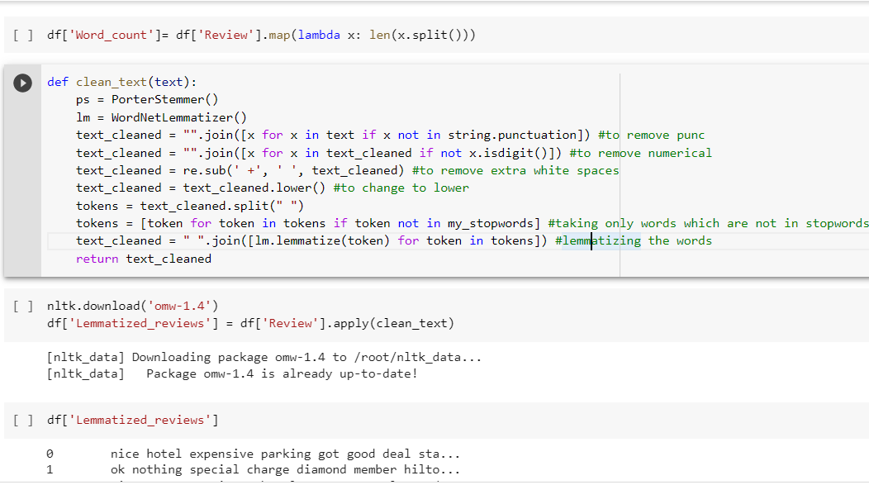
Data cleaning process: Tokenization:
Tokenization is the breaking of the document or sentences in chunks.
Normalization:
Text normalization is a pre-processing step aimed at improving the quality of the text and making it suitable for machines to process.

Slide 12
Stop words:
The words which are generally filtered out before processing a natural language are called stop words.
Lemmatization:
Lemmatization is that switches any kind of a word to its
base root mode.
Therefore the data cleaning process shows that remove of
the stop words, punctuation marks, words converted in to
lower case, lemmatization and tokenization.

Slide 13
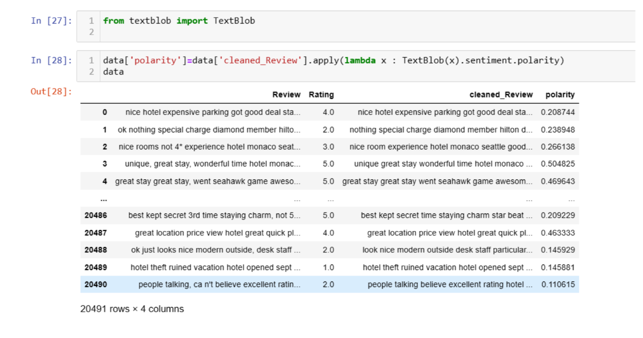
Polarity is float which lies in the range of [-1,1] where 1
means positive statement and -1 means a negative
statement.

Slide 14
Model building:-
Naïve bayes
Decision tree classifier
Logistic Regression
Random forest
Ada boost classifier
K -Nearest Neighbour (KNN)

Slide 15
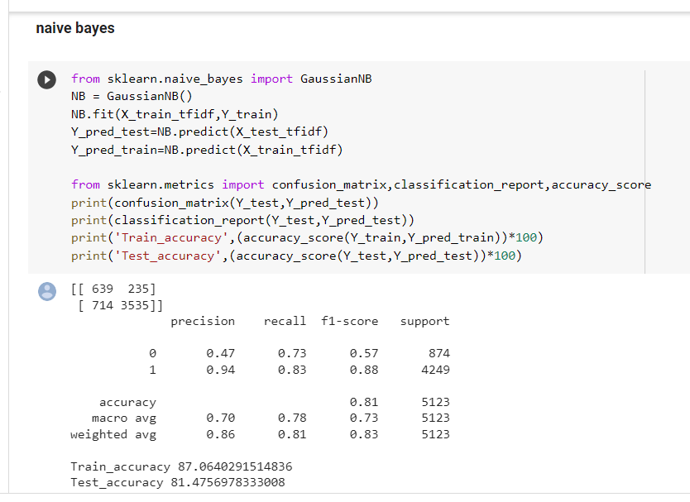
Naïve bayes:-

Slide 16
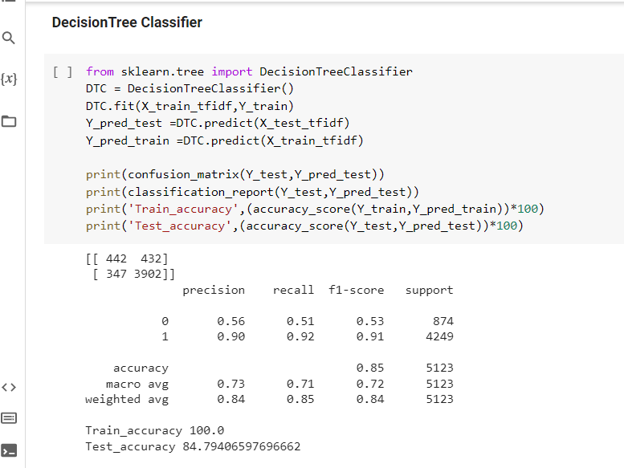
Decision tree classifier:-

Slide 17
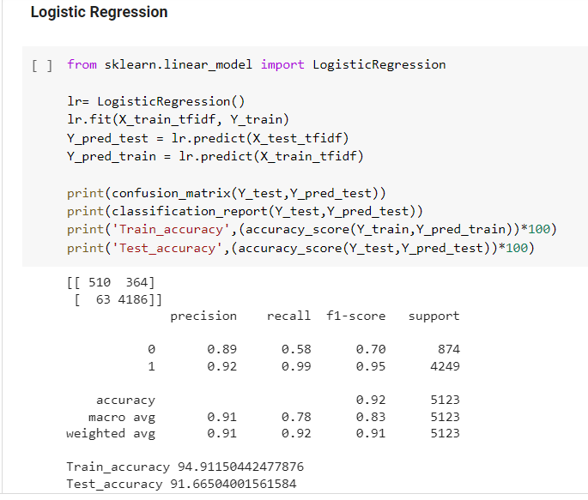
Logistic regression:-

Slide 18
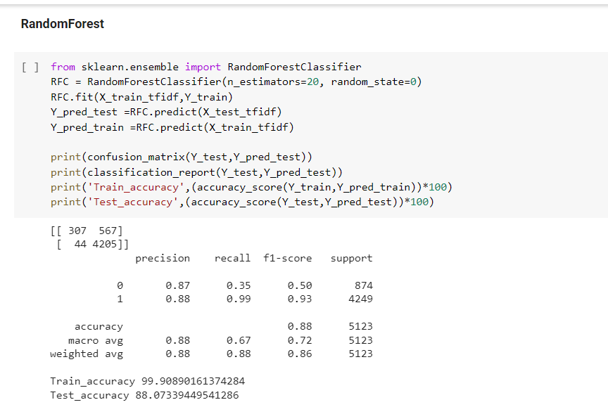
Random forest:-

Slide 19
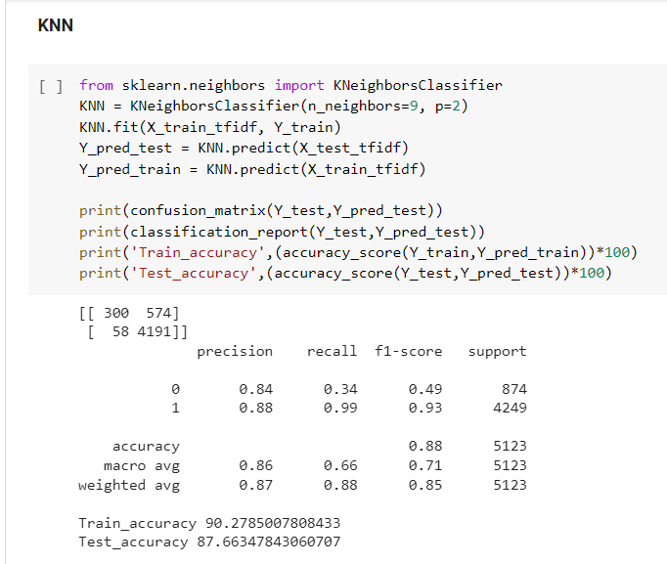
KNN:-

Slide 20
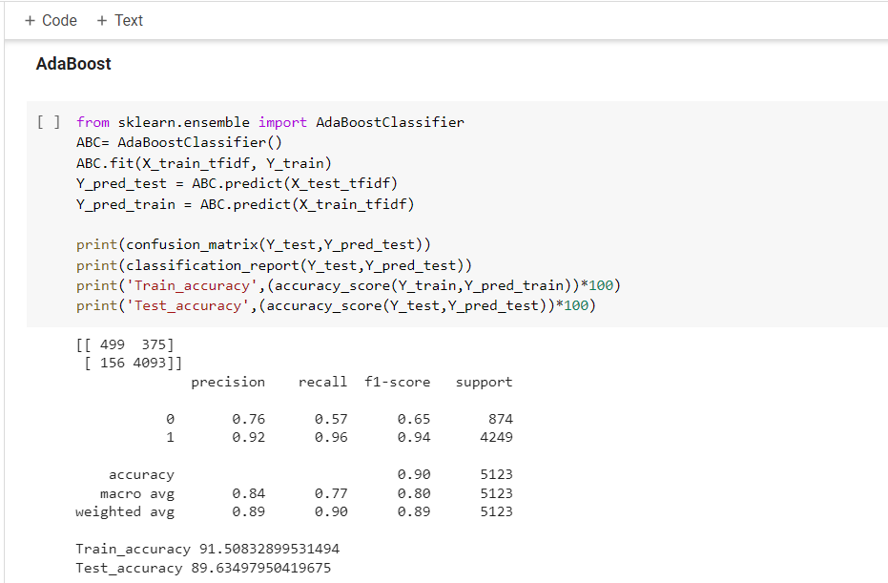
ADA Boost:-

Slide 21
Finalized model:-
After checking accuracy of the models we have decided
to use logistic regression for deployment.
The accuracy for logistic regression is 91.66% and 94.91% for test and train respectively

Slide 22
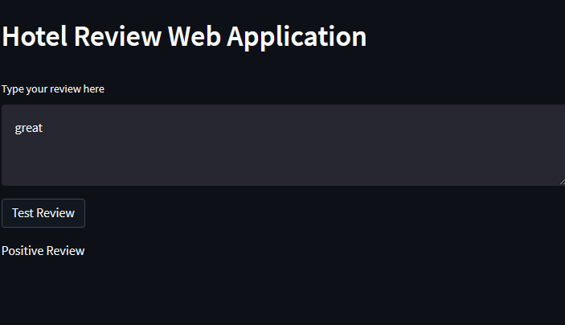
Deployment:-
Before we deploy our model, we need to load our model in our
pickle format from where stream lit will run our main python file.
Saving the .py and .pickle file in our path so that we can run them locally.

Slide 23
Conclusion:-
Hotel rating systems are related to service quality improvement, while service quality improvement is associated with changes in hotel performance.
All models performed accurately but logistic regression gave the highest accuracy there we used this model for deployment.

Slide 24
THANK YOU

